Slide 1
Class of 2026
Junior Seminar

Slide 2
Meet your Counselors
University A-G: Elizabeth Ryczek
University H-O: Tim Papp
University P-Z: Amanda Madej
Medical: Erika Picard
College and Career Readiness Coordinator: Sarah Lopez

Slide 3
Know your Graduation Requirements
24 credits
Must meet all subject level credit requirements!
GPA
Minimum 2.0 unweighted
Testing
Pass Alg 1 EOC and FAST ELA

Slide 4
Testing
Must PASS FAST PM 3 Reading
OR earn a concordant score in one of the following ways:
480 on SAT EBRW
Average of 18 on ACT Reading and English
Must Pass Alg 1 EOC
OR earn a concordant score in one of the following ways:
420 SAT Math
16 ACT Math
430 PSAT Math
Sum 36 Verbal Reasoning/Grammar on CLT
11 CLT Quantitative

Slide 5
What credits do I need to graduate?
English
4 credits
Math
4 credits, must include Algebra 1 (1.0) and Geometry (1.0)
Science
3 credits, must include Biology (1.0)
Social Studies
American Government (0.5)
Economics (0.5)
US History (1.0)
World History (1.0)

Slide 6
Credits
Fine Arts
1 credit in fine/performing or CTE course
HOPE
Health Opportunities through Physical Education
OR PE through sports (2 years JV or Varsity-same sport) form must be signed and input into your course history

Slide 7
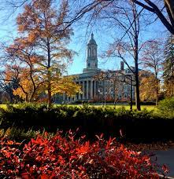
4 Year College/University Requirements
In addition to HS Grad requirements you must take:
Algebra 2
2 or 3 years of foreign language (consecutive, same language)
Recommendation:
take foreign language throughout HS
take advanced coursework (AP, DE, AICE, Honors)
take additional math and science courses (as advanced as you can)

Slide 8
Post Secondary Options
What are your choices?
4-year college/university
2-year college
Tech/Trade school
Military—test required
Work Force

Slide 9
Where do you want to go?
Florida Shines – www.floridashines.org
Big Future Collegeboard – www.bigfuture.collegeboard.org
Admittedly – admitted.ly
Cappex – cappex.com
Chegg – chegg.com
College Raptor – collegeraptor.com
NACA – nacacnet.org
Kahn Academy – khanacademy.org/college-admissions
Xello

Slide 10
Need Help?
Math homework help Tuesdays 2:05-4:05 room 19-131 all math levels
Make appointment to stay after with your teacher other subjects
Homework helpline: 727 547 7223, staffed by teachers 5-8pm Mon-Thurs
After school credit recovery ELP- core academic classes only (see counselor for registration)
Mondays-Thursdays 2-4pm 19-207
English-Mon & Wed
Math- Tues & Thurs
Science- Mon & Wed
Social Studies- Mon, Tues, Wed, Thurs
You MUST attend if you failed any core classes to recover credit and get on track for graduation

Slide 11
Register to take SAT and/or ACT
SAT
You are all registered to take a FREE in school SAT in March
To register for additional SAT exams go to: www.collegeboard.org
ACT
www.actstudent.org

Slide 12
PSAT NMSQT
All 11th grade students are automatically registered to take the PSAT/NMSQT in school on Wed Oct 9th
To prepare go to www.satpractice.org or Albert i.o (Clever)
Why is it important to take this in 11th grade?
Scholarships
National Merit
Preliminary SAT

Slide 13
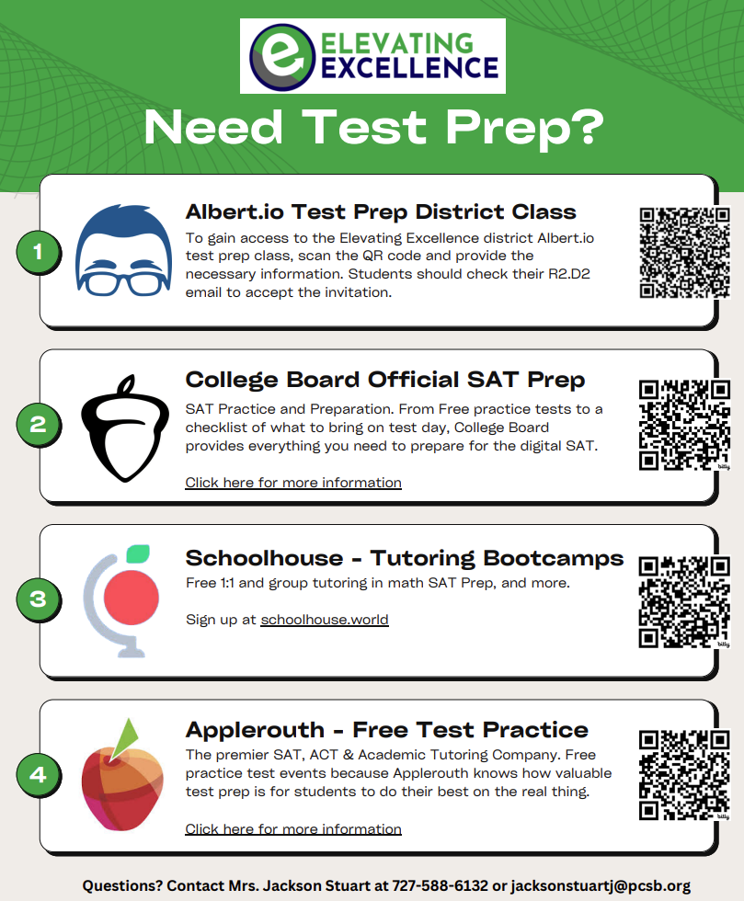

Slide 14
Bright Future Scholarship
3 levels
All require:
Volunteer hours OR paid work hours (different amount for each)
4 credits English
4 credits Math (Alg 1 and higher)
3 credits Science
3 credits Social Studies
2 credits World Language (sequential, same language!)
SAT/ACT scores
https://www.floridastudentfinancialaidsg.org/SAPBFMAIN/SAPBFMAIN

Slide 15
Florida Academic Scholar (FAS)
100 volunteer hours or 100 paid work hours or combination (100 total)
3.5 weighted GPA, calculated from required coursework only
Electives are not factored into BF GPA
29 ACT composite score (includes Reading, English, Math, Science) OR
1330 SAT composite score

Slide 16
Florida Medallion Scholar (FMS)
75 volunteer hours or 100 paid work hours or combination (100 total)
3.0 weighted GPA, calculated from required coursework only
Electives are not factored into BF GPA
24 ACT composite score (includes English, Reading, Math, Science) OR
1190 SAT composite score

Slide 17
Gold Seal Vocational Scholar (GSV)
Gold Seal Vocational Scholar (GSV)
3.0 weighted GPA
Take at least 3 full credits in a single Career and Technical Education program
Achieve the required minimum 3.5 unweighted GPA in the career education courses
30 volunteer hours or 100 paid work hours
Achieve the required minimum score on the ACT, SAT, or PERT
ACT- 17 English, 19 Reading, 19 Math
SAT-24 Reading, 24 Math, Writing and Language 25
PERT-106 Reading, 103 Writing, 114 Math

Slide 18
Gold Seal CAPE Scholar
Gold Seal Cape Scholar (GSC)
30 volunteer hours or 100 paid work hours
Earn minimum of 5 postsecondary credit hours through CAPE industry certifications that articulate for college credit
Restrictions
Until a student has earned an eligible associate degree, GSC scholarships may only be used at postsecondary institutions that offer an applied technology diploma, technical degree education program (associate in applied science or associate in science), or a career certificate program.
Upon completion of an eligible associate degree program, a GSC Scholar may also receive an award for a maximum of 60 credit hours toward an eligible baccalaureate degree

Slide 19
Dual Enrollment at SPC
3.0 unweighted GPA
Take PERT and earn qualifying scores or can use SAT, PSAT, or ACT
Take up to 3 courses off campus at SPC
Courses we have on campus: Composition I and II, Intermediate Algebra/College Algebra, Career & Life Planning (2.5 GPA)
See counselor to fill out DE permission form and sign up for classes
Spring enrollment opens October closes Nov 15th

Slide 20
Early Admission-12th grade at SPC
Unweighted cumulative GPA of 3.0 or higher.
Satisfactory scores on the PERT or PSAT/SAT/ACT.
Completion of the HOPE, Geometry, Biology, and World history graduation requirements.
All standardized state assessment graduation requirements met.
Completion and submission of the Application for Early Admission on the SRS system (parent must complete this with their portal login)
Enrollment in a minimum of 15 credit hours each term and maintaining at least a 2.0 (C average) college GPA.
Transportation to classes at SPC.
Deadline is January-Priority; February-final! This is a lottery, admission is not guaranteed

Slide 21
High school students attending Pinellas Technical College (PTC) have the opportunity to be dual enrolled in post-secondary courses tuition free! These courses give students credits toward a high school diploma and a career technical certificate.
Requirements:
Be at least 16 years old and entering their junior or senior year in high school
Have a minimum cumulative unweighted GPA of 2.0, or 2.5 GPA for medical-related programs
Show responsibility through high school attendance and behavior.
Obtain a Dual Enrollment Application from their high school counselor.
Return completed application to their high school counselor, with all necessary signatures.
Once the PTC counselor has received the application, the student will be contacted regarding a shadowing date.

Slide 22
College and Career Fairs
North Pinellas County College & Career Fair
September 26, 2024
6:00 PM - 7:00 PM
Countryside High School
No registration necessary!

Slide 23
Fall 2024 College Visits
September Visits
9/10 - St Petersburg College (SPC)
9/19 – University of Florida
9/25- Florida State University
October Visits
10/4- American University
10/25- University of Central Florida

Slide 24
Looking for post secondary information?
Scholarships
Bright Futures
SAT/ACT
FAFSA
Technical Careers
Military
College
Ms. Lopez = College & Career Counselor
https://padlet.com/lopezsar/phuhs-college-and-career-center-scroll-right-for-more-info-ayot9wpbd3pggm8e

Slide 25
Padlet
University student Padlet
https://padlet.com/madeja/university-student-padlet-wci6imj5weyvz2pv
CCR Padlet
https://padlet.com/lopezsar/phuhs-college-and-career-center-scroll-right-for-more-info-ayot9wpbd3pggm8e

Slide 26
CWMP “Remind Invite”
EVERYONE Must Re-Enroll!!!
Junior (last name A-L): Text @cwmp2026-1 to the number 81010
Junior (last name M-Z): Text @cwmp2026-2 to the number 81010

Slide 27
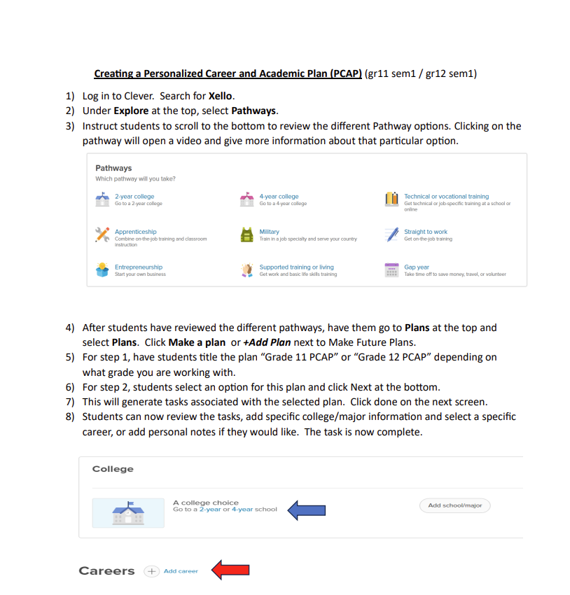
XELLO TASK

Slide 28
